Slide 1

Hospital With highs standard in Venezuela
Edgar Garcia
Coursera

Slide 2
INTRODUCTION
About Cities hospitals: Hospitals that meet the highest levels of health are being sought
The highest quality of healthcare service, innovative medical-surgical treatments, and recognized capacity in scientific research in the healthcare area.
The greater capacity of response to variations in the environment to continue offering an optimal health service.
The best and highest integrated functionality of engineering as support, support and vehicle for service and administration.
The most transparent, solid, and efficient management of material and financial resources that consolidate our management.

Slide 3
Interested Business:
The proyect can be used for promoted specific hospital and for insurers with they clients, to send more specific sick to th hospital with the treatment
Target audience:
Every pearson who want visit Venezuela with the most standars of safety.

Slide 4
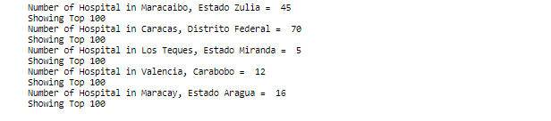
DATA:
For this study the principal data colector would be from www.foursquare.com with the API who provide all the information of the hospital in Venezuela and is a good start point to know the density and the distance between the city and the hospital,
Cities and Hospitals

Slide 5
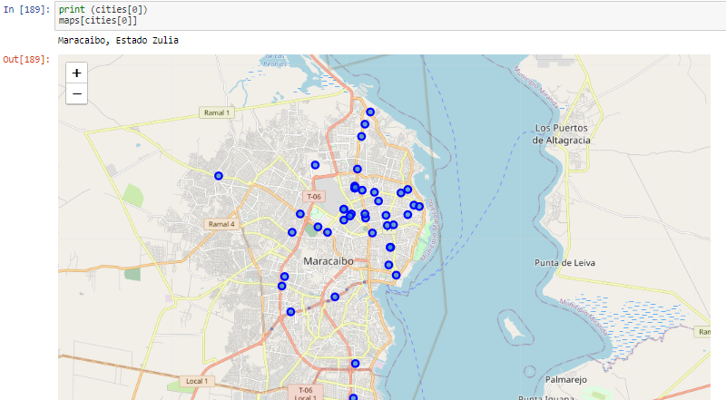
Maps of Cities
1-

Slide 6
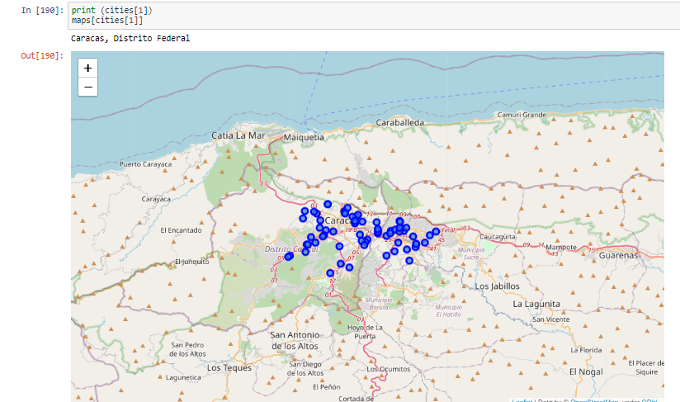
Maps of Cities
2-

Slide 7
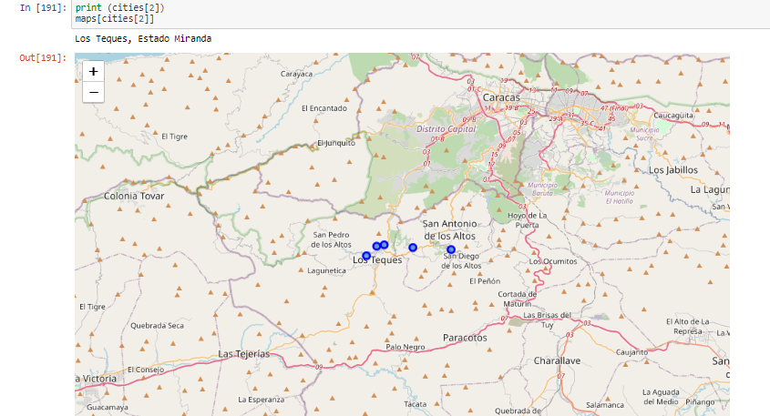
Map of cities
3

Slide 8
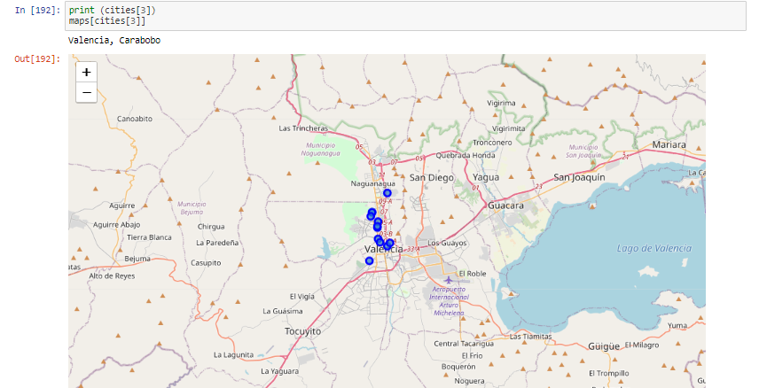
Map of cities
4

Slide 9
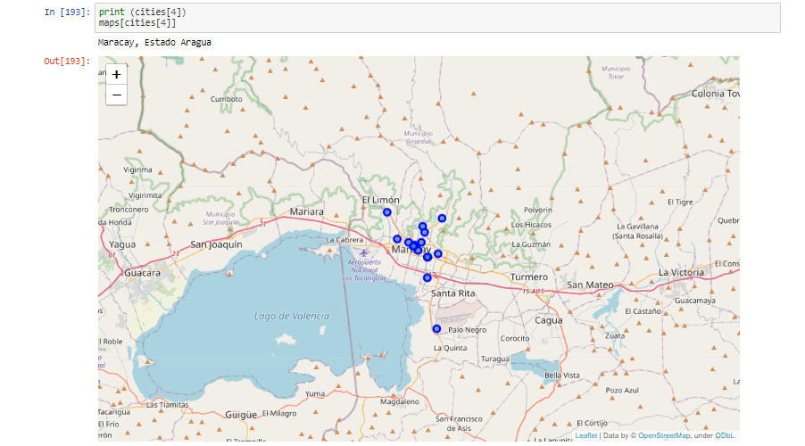
Map of cities
5-

Slide 10
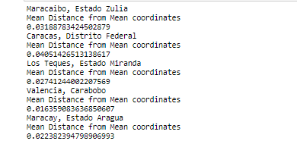
Mean distance

Slide 11

Conclusion and future directions
This model Will predict trow the time always witch is the best hospital by the density of population and by the distance from the middle of the city.
The best choise for the new visitor would be the city of Valencia state Carabobo because have the most density by population and the nearest hospital by miles.

